Slide 1

Industrial Machine Learning on Hadoop and Spark
Maks Nakhodnov, Bremen 2025

Slide 2
Distributed computing. MapReduce
Plan:
How to process big data?
MapReduce algorithm. Basic components.
Hadoop MapReduce

Slide 3
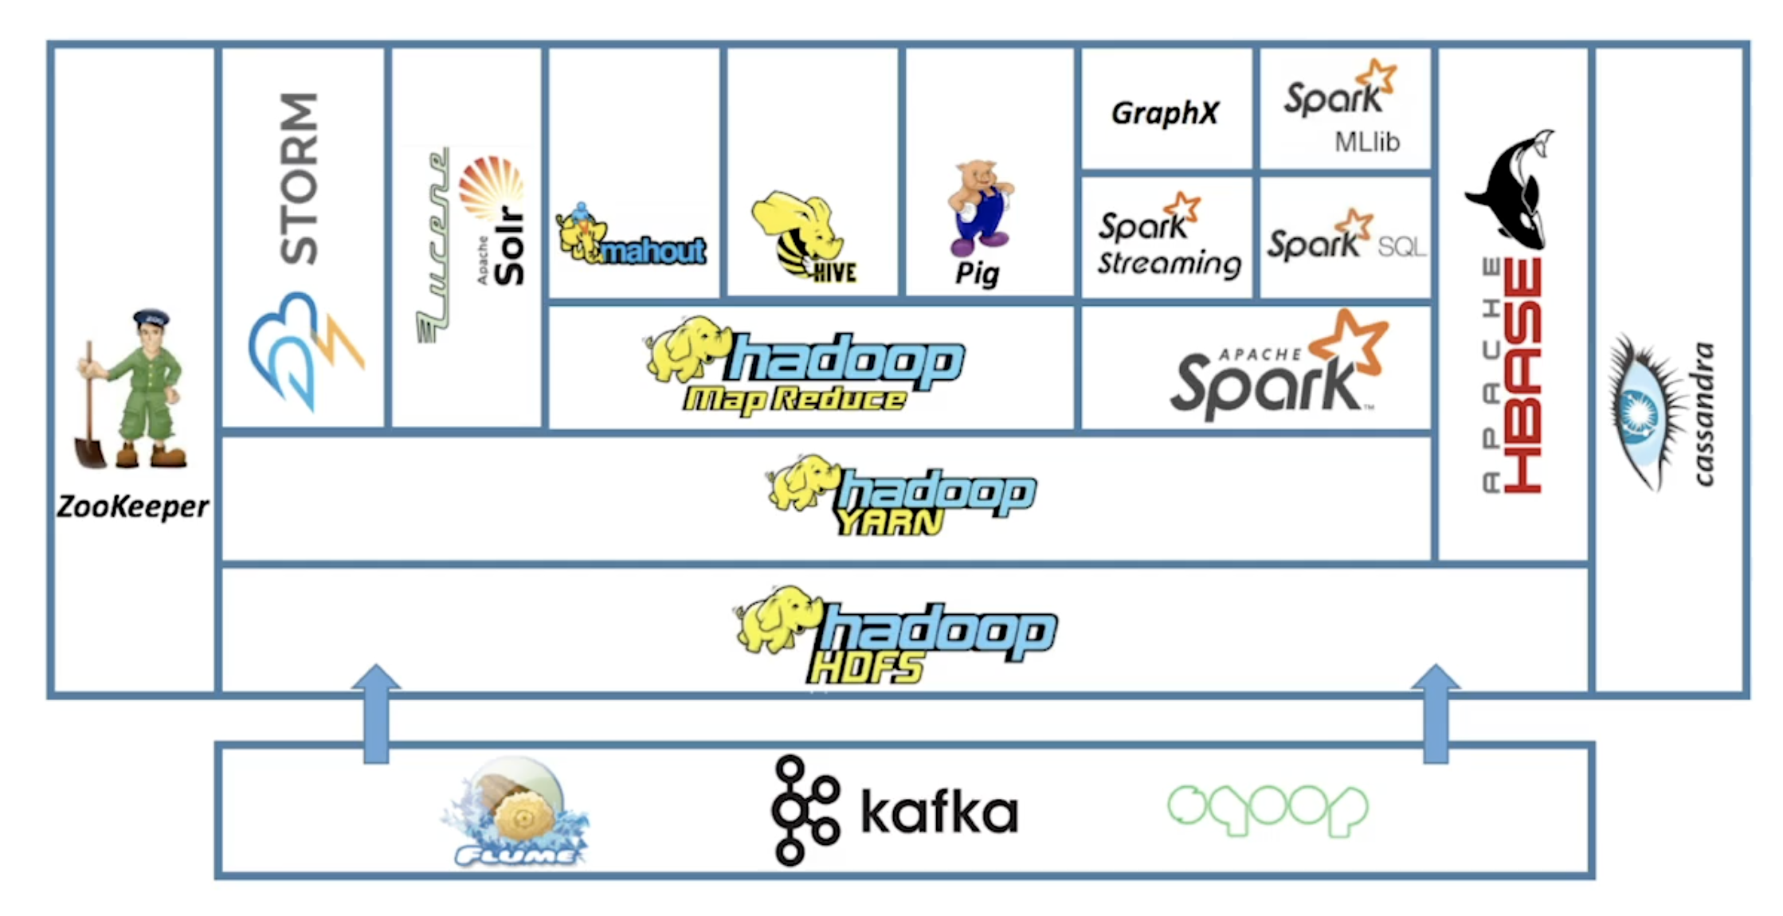
Hadoop Ecosystem

Slide 4
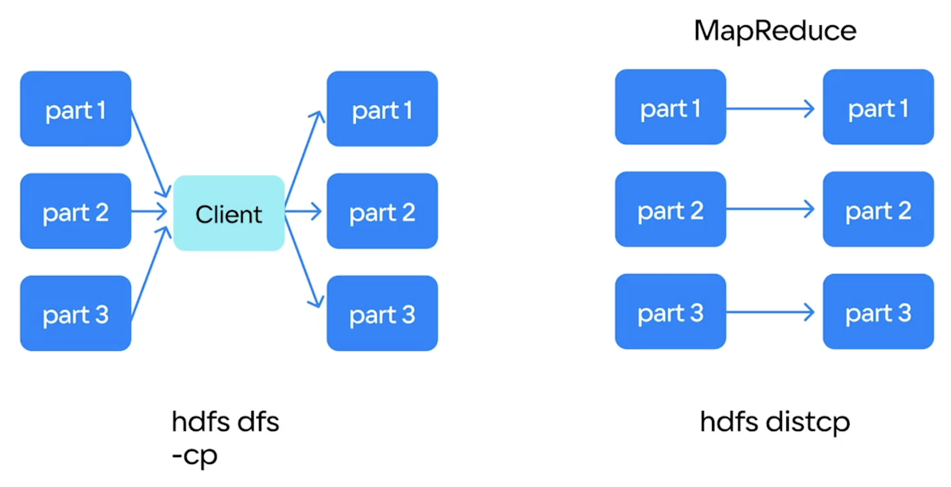
MapReduce. How to process data efficiently?
Data locality
Lack of efficient random access

Slide 5
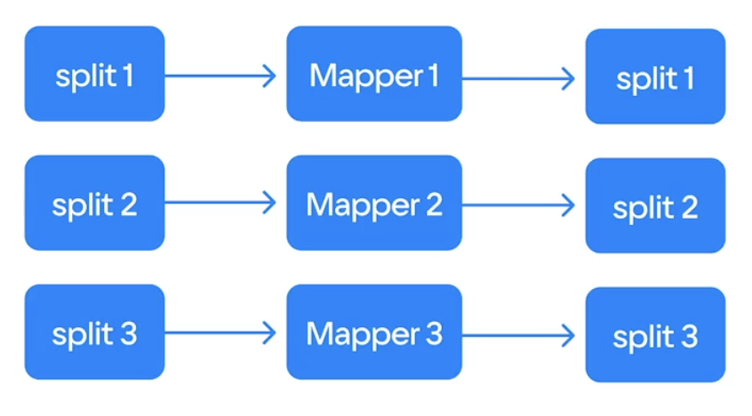
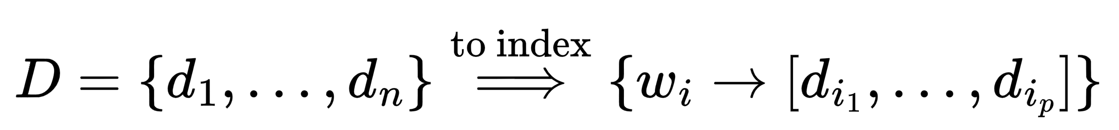
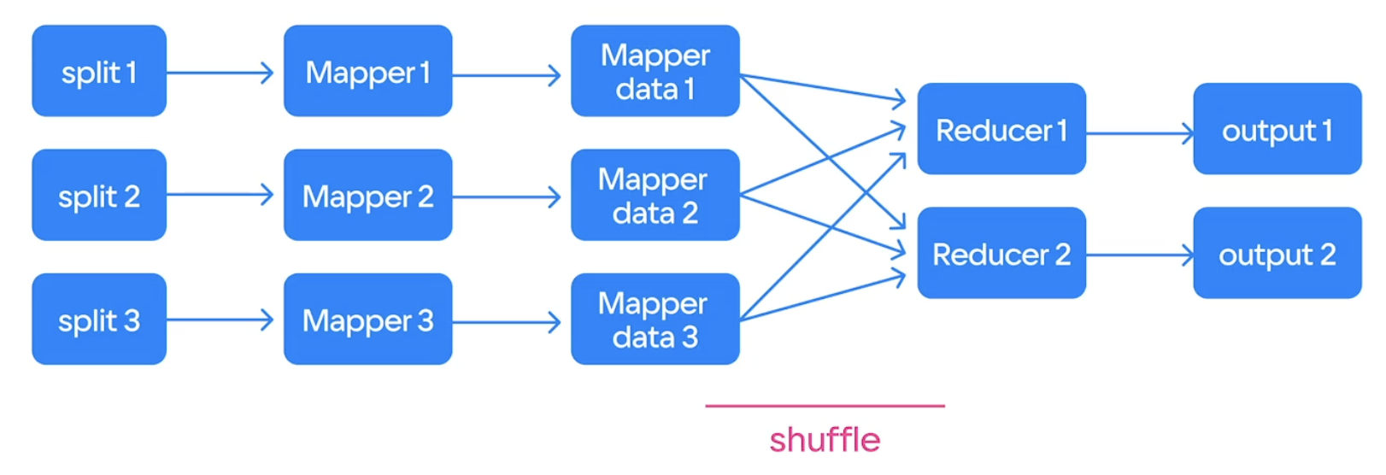
MapReduce. Massive data parallelism
Most of the processing tasks can be separated into individual subtasks
I. Example: Remove punctuation (no reduction)
1. Process each document independently
II. Example: Build an index for the data corpus
Process each document independently
Combine the results

Slide 6
MapReduce. Simple functional primitives
Stateless functional primitives that operate on immutable data:
- Allows reusability and reruns
- No shared memory
- Deterministic
List one-to-one transformation:
List reduction:

Slide 7
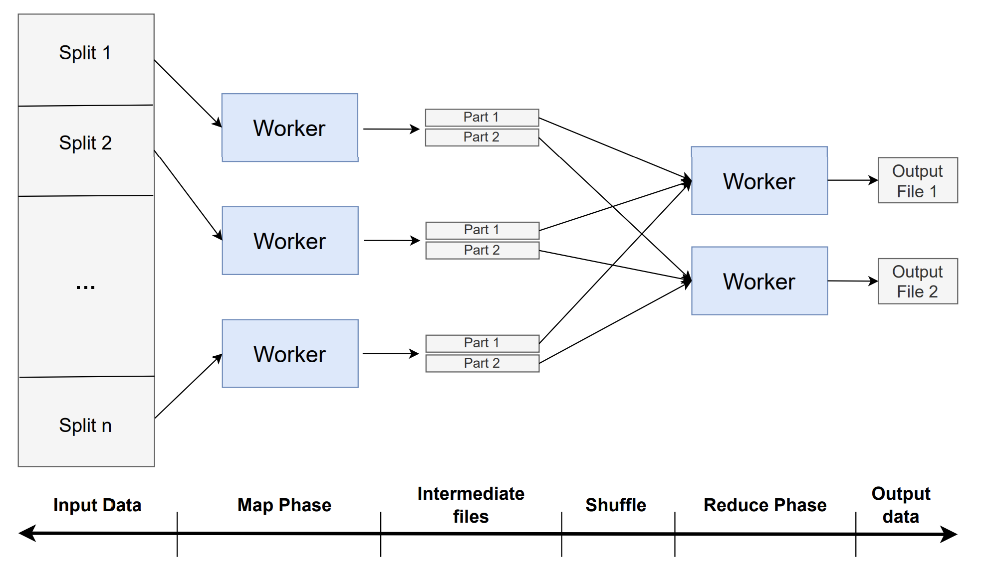
MapReduce Flow

Slide 8
MapReduce Flow. Massive data parallelism
Most of the processing tasks can be separated into individual subtasks
I. Example: Remove punctuation (no reduction)
1. Process each document independently
II. Example: Build an index for the data corpus
Process each document independently
Combine the results

Slide 9
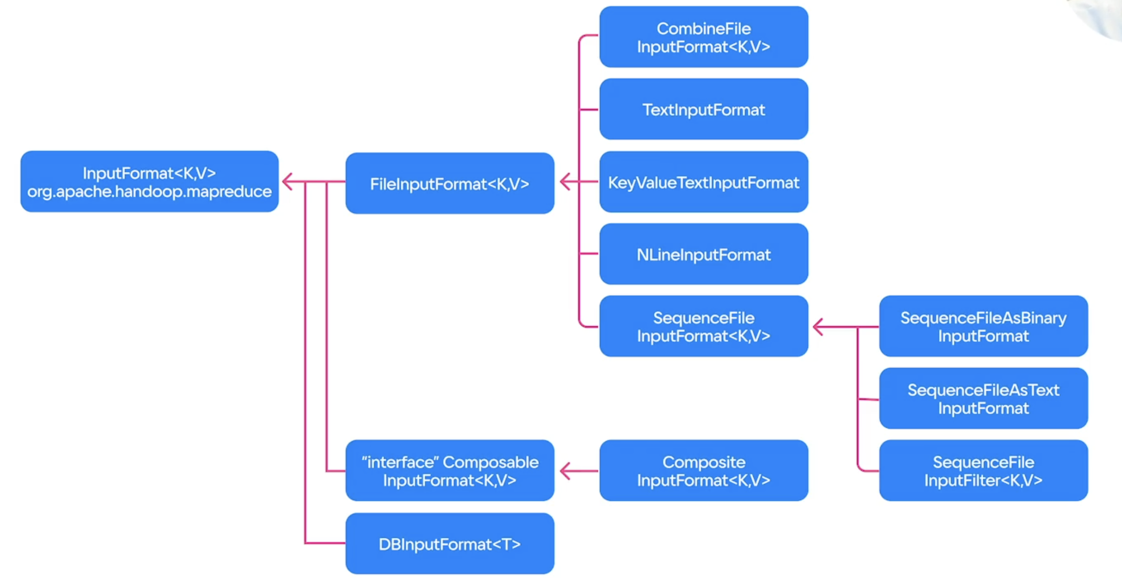
MapReduce Flow. Input Data
A single file or a group of files
Located in HDFS
Allows it to be split into independent chunks
A key-value representation
Various data sources:
Various text formats
Splitable archives (.bzip2)
SQL databases (Cassandra)

Slide 10
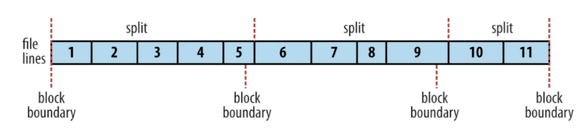
MapReduce Flow. Input Data
Split size: max(minSize, min(maxSize, blockSize))
maxSize —> mapred.max.split.size
minSize —> mapred.min.split.size
blockSize —> HDFS block size
Lower split size —> better data locality
Lower split size —> better fault tolerance
Larger split size —> lower computational overhead

Slide 11
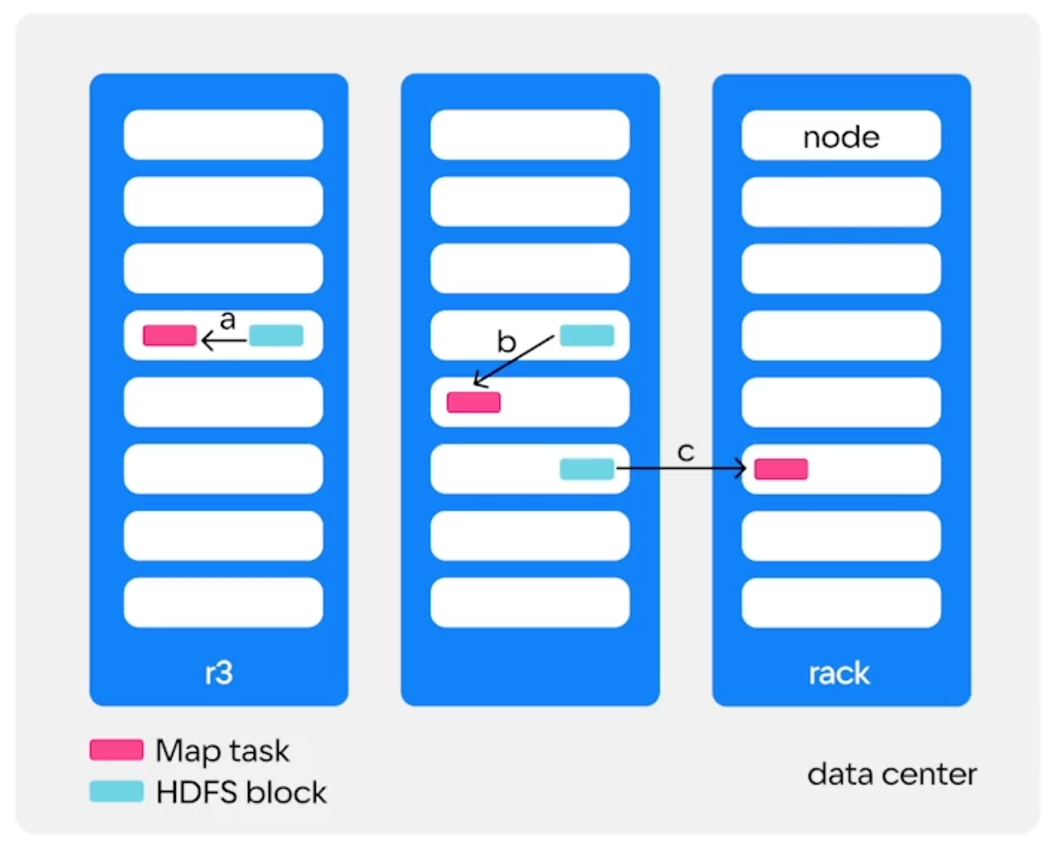
MapReduce Flow. Map Phase
Independent workers
Transforms the sequence of KV pairs from the split
Number of mappers equal to the number of splits
Tries to have data locality, but not as important nowadays

Slide 12
MapReduce Flow. Intermediate data
Mapper output is partitioned by the key — one file for each reducer (Partitioner) - P(K) = hash(K) % #Reduces
- Spill files are created before the local merge (multi-way merge sort)
- Salting: key —> (key, salt)
Each file is sorted by key (SortComparator) - Distributed sorting
- Allows for secondary sort
Usually stored in the local FC (instead of HDFS)
- Reduces replication overhead
- Cause recomputations in case of failure

Slide 13
MapReduce Flow. Combiner
The Optional Combiner Phase can perform reduction locally to decrease the amount of data transferred through the network
Pure optimization execution: has to be an associative (a⊕b)⊕c = a⊕(b⊕c) and commutative a⊕b = b⊕a function
Has to be compatible with Mapper output and Reducer input formats

Slide 14
MapReduce Flow. Shuffle
The most network-heavy part of the framework
Key optimization factor
Second part of the distributed sorting
Merge the sorted lists
Additional Combiner calls are possible
The sorted list of keys is separated into groups of values with the “same” key (GroupingComparator)

Slide 15
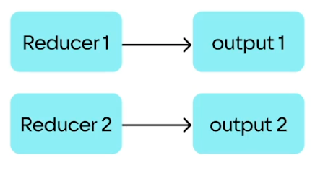
MapReduce Flow. Reduce Phase
The sequence of groups (K, [V1, …, Vp]) is passed to the reducer to be aggregated
The resulting sequence of KV pairs is written into HDFS as it is

Slide 16
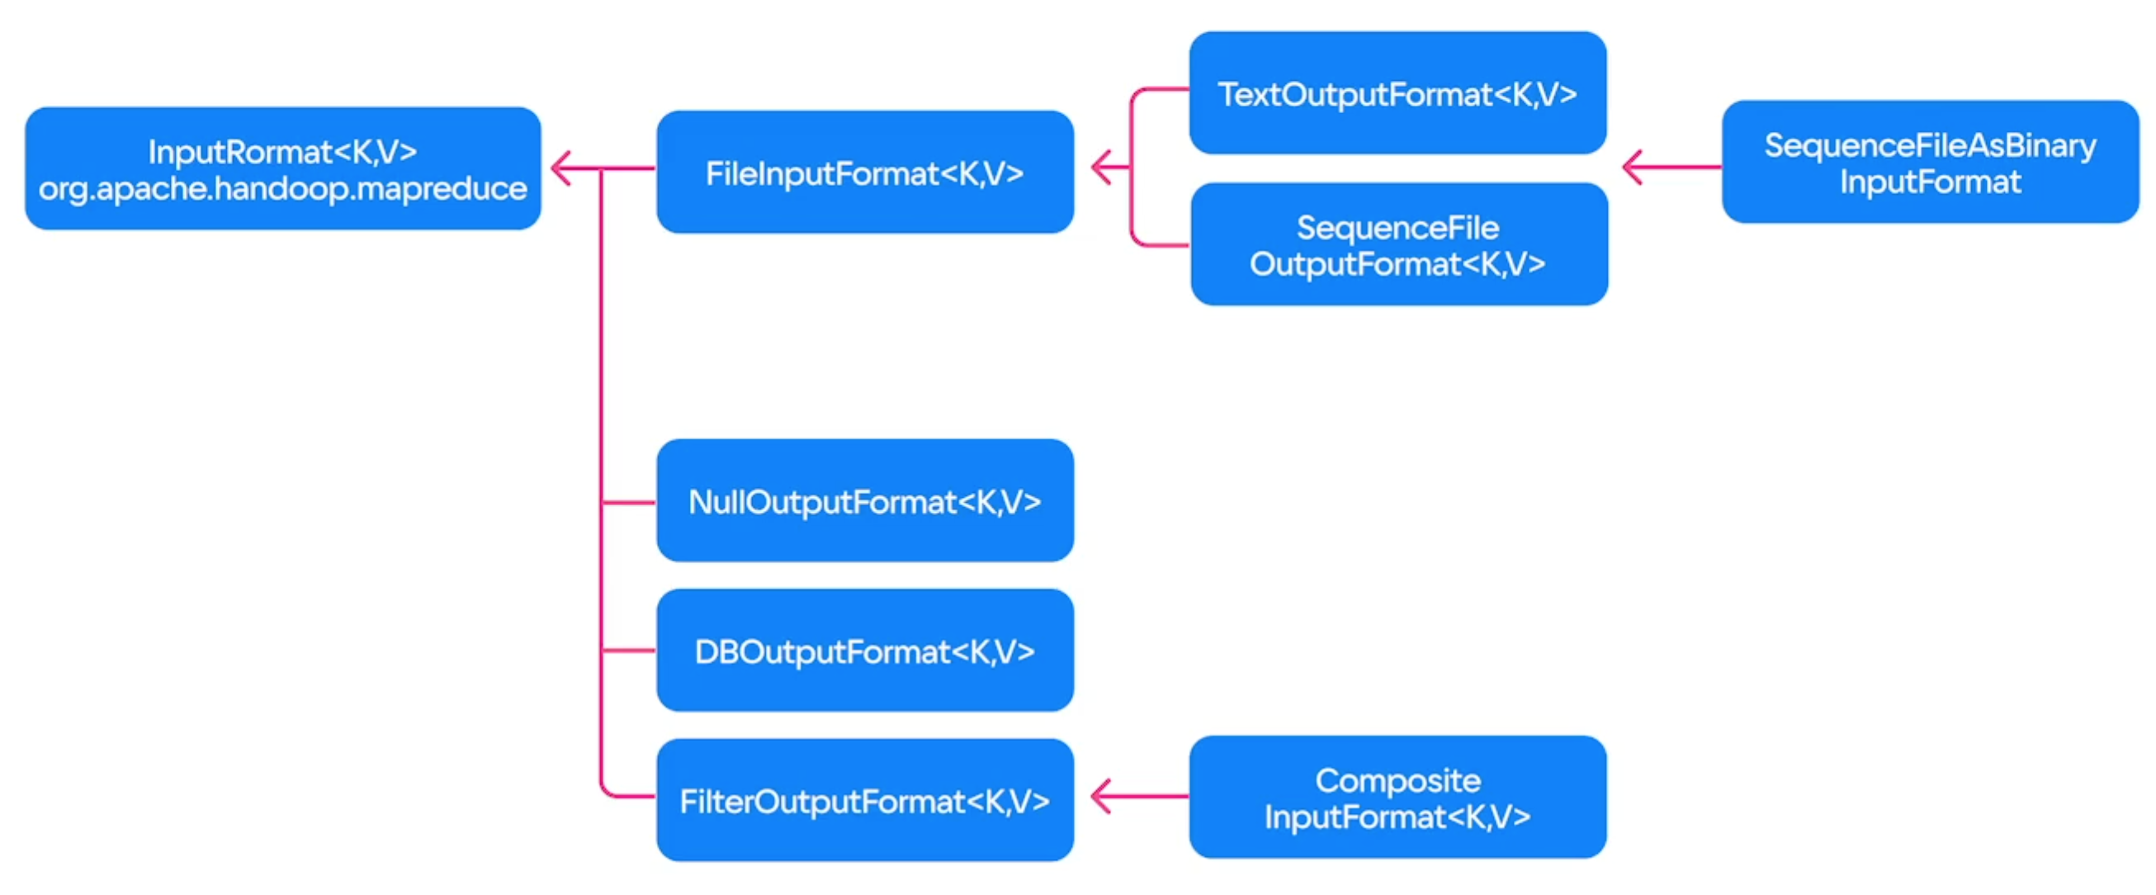
MapReduce Flow. Output Data
Stored in HDFS
The number of output files is equal to the number of reducers

Slide 17
MapReduce Flow. What can you change?
Input data location
Input data KV representation and size of data splits
Mapper function
Partitioner
Primary Sort Comparator
Combiner
Secondary Sort Comparator (Grouping Comparator)
Reducer
Output data location

Slide 18
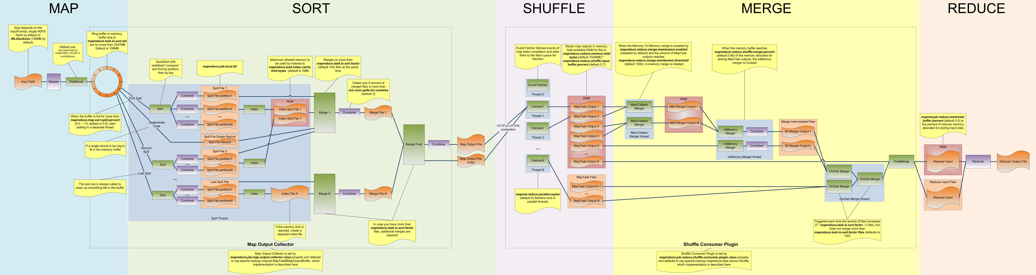
MapReduce Flow

Slide 19
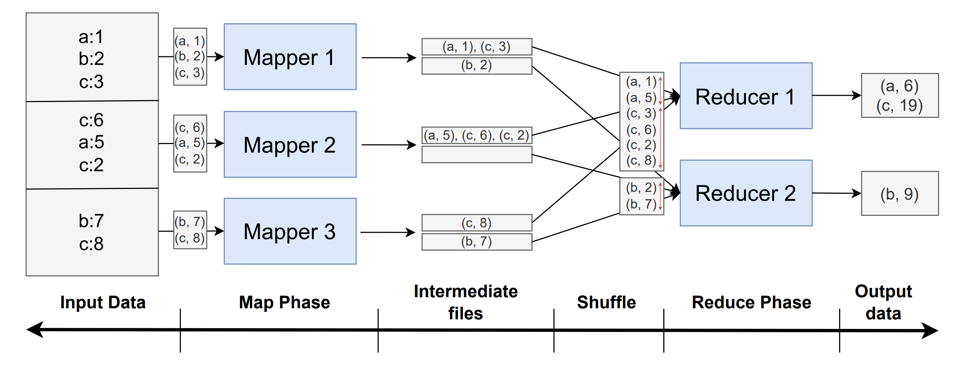
MapReduce Flow. Example

Slide 20
MapReduce Flow. Fault tolerance
Input and output data are stored in HDFS, which ensures their availability
If any intermediate data is lost, just recompute it from scratch — stateless, deterministic Map/Reduce is required
If the Map Phase takes too long, it might be beneficial to separate the MapReduce task into the Map-only and Reduce-only tasks to store intermediate results in HDFS

Slide 21
MapReduce Flow. Speculative execution
Tasks (map/reduce) can be executed multiple times if the process stalls on one of the nodes
The first result to be computed is accepted; others are discarded
Stateless, deterministic Map/Reduce is required
mapreduce.map.speculative
mapreduce.reduce.speculative
Helps against straggler-tasks and the “long tail”

Slide 22
MapReduce Flow. Reducer input imbalance
The user has to ensure that all reducers are utilized equally
The load imbalance can be solved using a custom partitioner
Example. Websites Processing: (URL, Content) —> Statistics
- URL can be distributed unequally
- i.e., google.com is much more frequent
- Naïve hash partitioning will create load imbalance

Slide 23
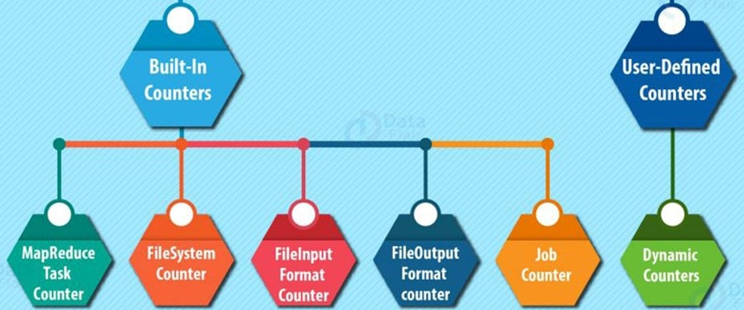
MapReduce. Counters
Mechanism for monitoring and collecting non-important results
Expensive to update
Can only be a 64-bit integer
Non-deterministic by design (i.e., task reruns)
Available from UI to monitor execution
Either built-in or user-defined:

